Slide 1

Traffic Light Detection and Recognition System
Members:
Muktadir-Us-Saleheen (011221200)
Md. Raisul Islam Pranto (011201078)
Md. Ifat Hasan(011201080)

Slide 2
Idea
Creating a system that can detect and recognize traffic lights by itself.
Will provide “Red Light” “Yellow Light" and “Green Light” based on situation.

Slide 3
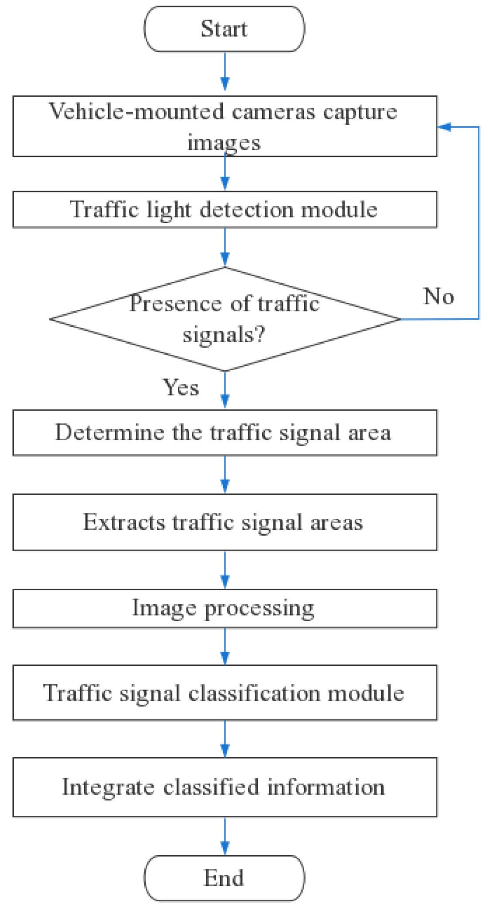
Algorithm/Paper
Paper : “Traffic Light Detection and Recognition Method Based on YOLOv5s and AlexNet”
Source: https://www.mdpi.com/2076-3417/12/21/10808
Source: https://www.mdpi.com/2076-3417/12/21/10808

Slide 4
Dataset
“Traffic Light Detection Computer Vision Project” Dataset
Source: https://universe.roboflow.com/lenkaleeszabocapstone/traffic-light-detection-mlnz7

Slide 5
Issue
No issue has been found yet.

Slide 6
Thank you!

